Slide 1
Content
Point Estimates
Sampling distribution
Standard error of the Mean (SEM)
Influence of Sample size on Standard error of the mean

Slide 2
Point estimates (Point Estimates)

Slide 3
Example: Manufacture of apple juice
During the manufacture of each packet of juice, the quality control takes 15 samples to see whether the sample packet contain the required amount of juice.
The goal of the company is to always maintain mean content in the package to be 3200 ml.
The samples taken will be tested and will be used to make inference for the entire population (all the packages that is manufactured).

Slide 4
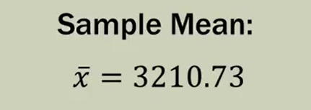
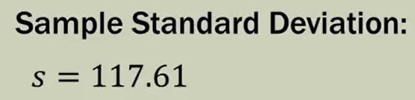
Sample of packaged apple juice
Sl no | Sample
1 | 3193
2 | 3124
3 | 3153
4 | 3145
5 | 3093
6 | 3466
7 | 3355
8 | 2979
9 | 3182
10 | 3227
11 | 3256
12 | 3332
13 | 3204
14 | 3282
15 | 3170
What is the mean of the sample?
What is the Standard deviation of the sample?

Slide 5
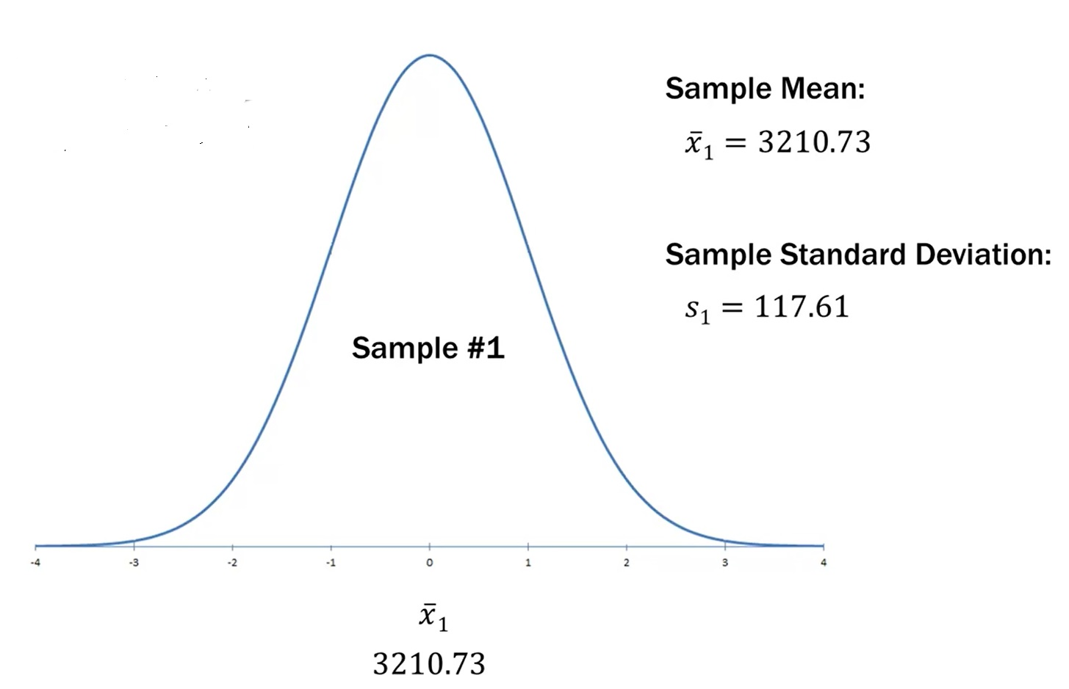
Plotting distribution of observation (size 15) in sample 1

Slide 6
Did the packages products achieved the company’s goal?
Company’s goal = 3200 ml.
Sample mean = 3210.73
Yes, the packaged product achieved the company’s goal as the sample mean is close enough.
Does this sample accurately reflect the volume of apple juice in the packet? Or does the sample mean reflect the accurate result which can be representative of population?
Do you think the sample result can be concluded for population?
Yes, the result can now be used for parameters and statistics.

Slide 7
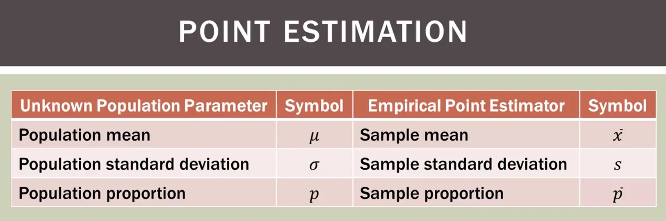
The parameters and Statistics are Known as point estimators (Point Estimates)

Slide 8
Sampling distribution

Slide 9
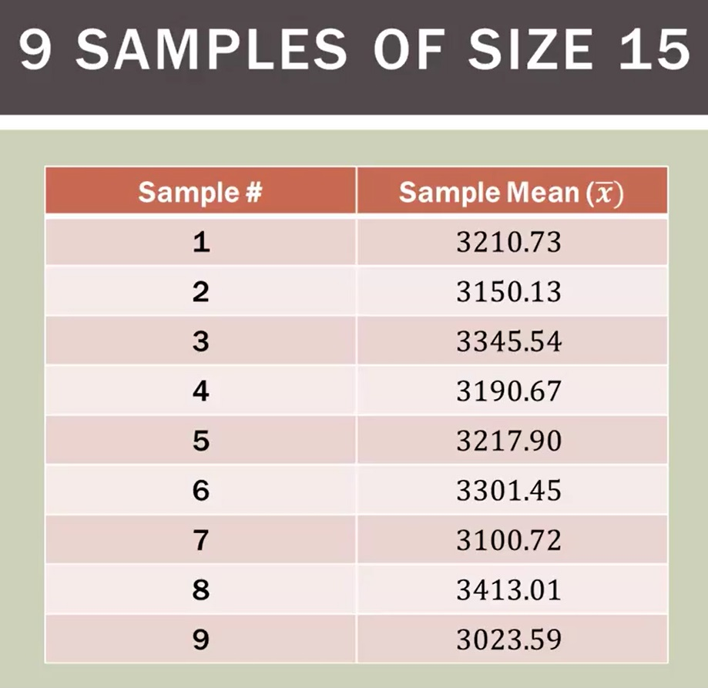
Lets take multiple samples (e.g. 15 packages X 9 samples)

Slide 10
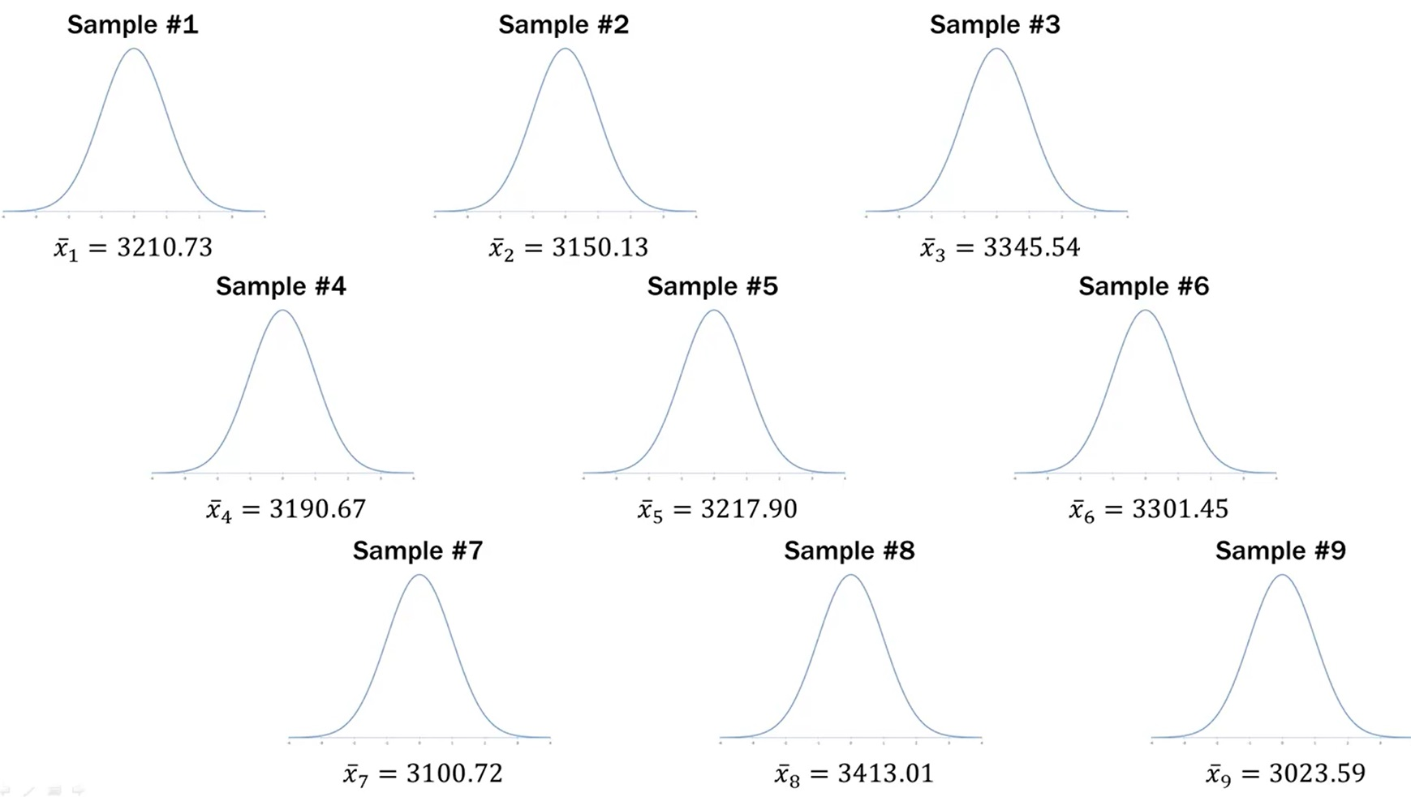
Plot the samples (9)

Slide 11
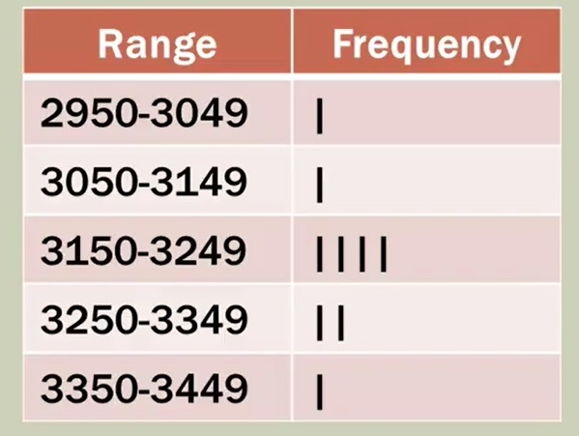
Lets take multiple samples

Slide 12
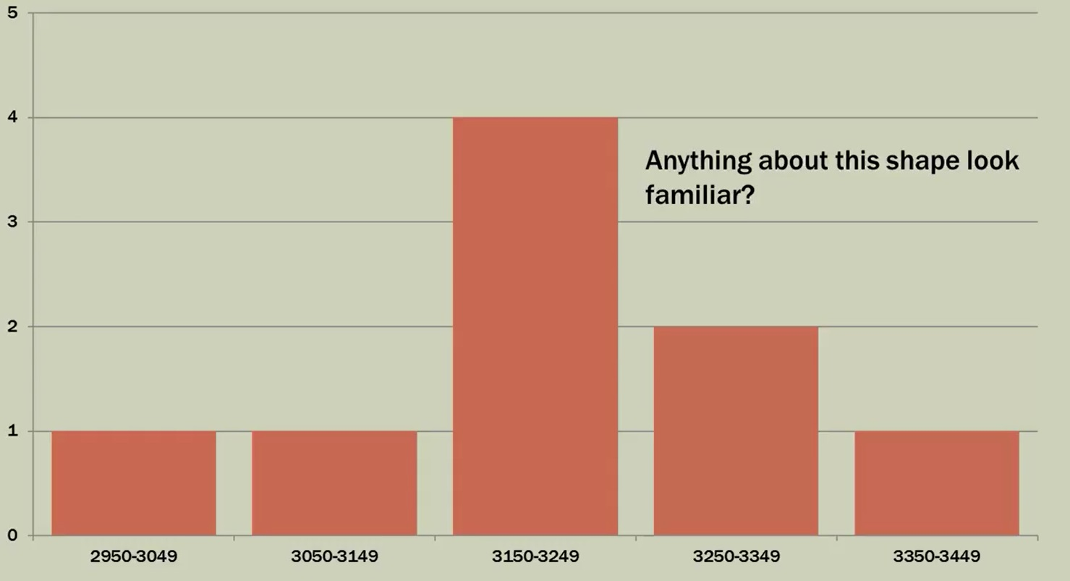
Sampling distribution: the distribution of samples in the frequency class.

Slide 13
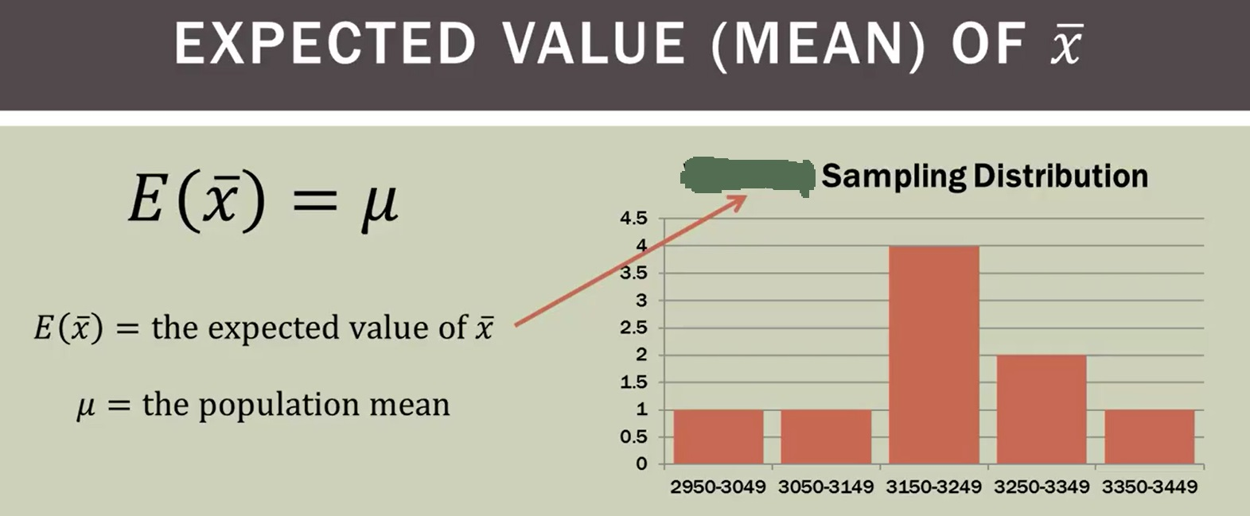
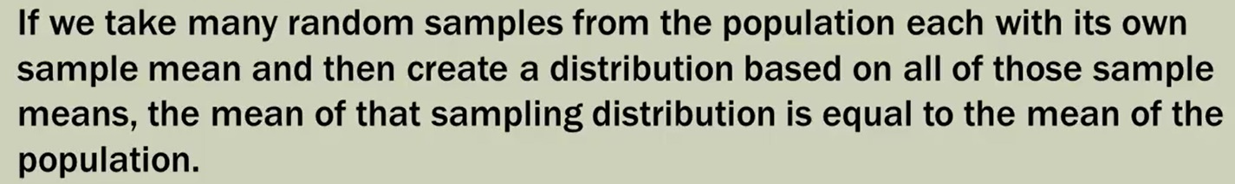
Can sample mean be used as substitute for population mean?

Slide 14
Apple Juice Packaging population parameters
Lets say that we know the total number of packets of apple Juice produced by the company (Zimdra for example).
Lets say the population mean (µ) = 3200 ml, and the population Standard Deviation (σ) = 150.

Slide 15
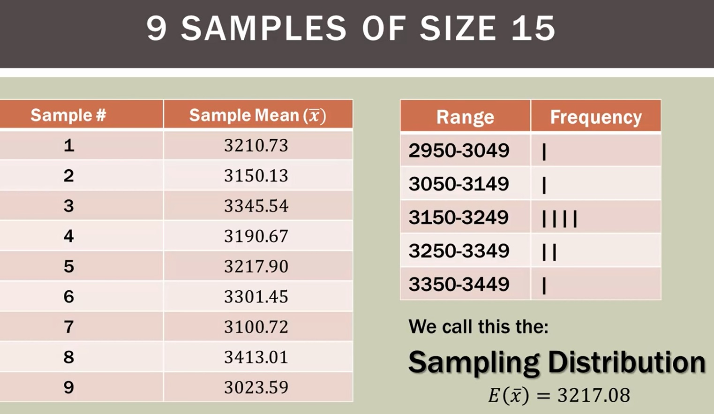
Sampling distribution (see frequency below)

Slide 16
SEM (Standard error of the Mean)

Slide 17
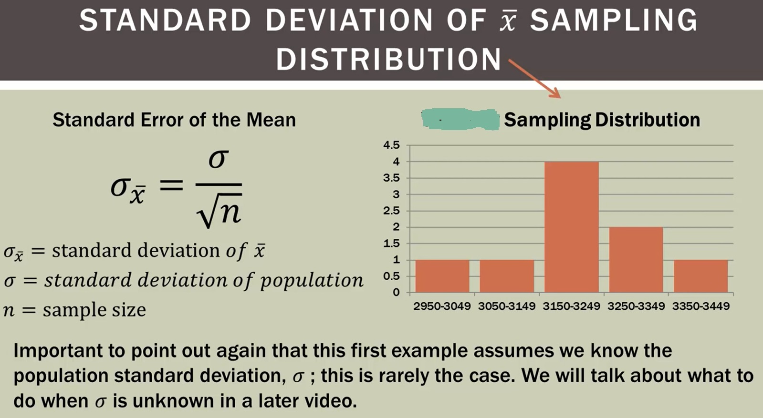
Standard Error of the Mean (Standard Deviation of the mean)

Slide 18
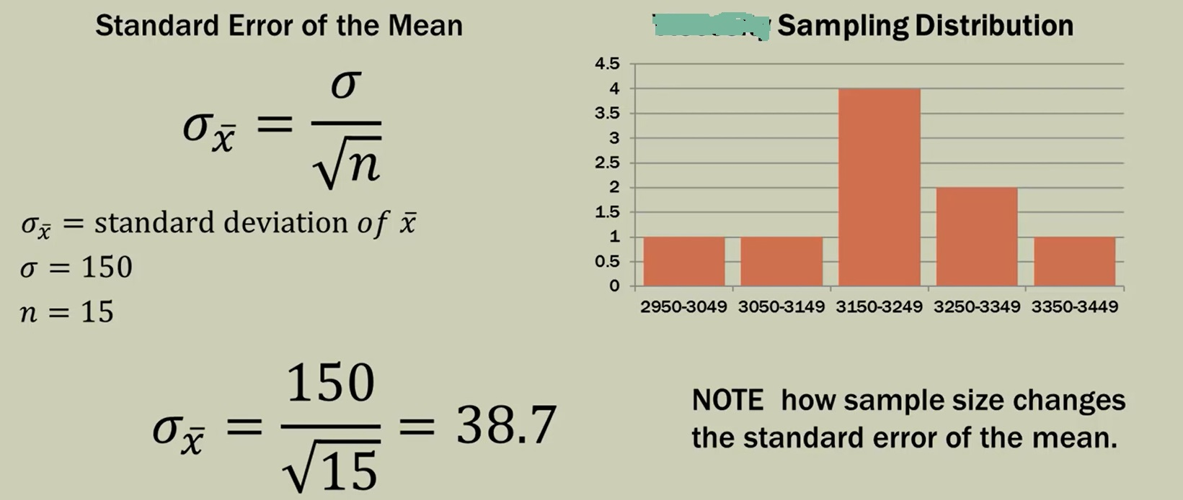
How sample size changes standard error of the mean?

Slide 19
Influence of Sample Size on the Standard Error of the Mean (SEM)

Slide 20
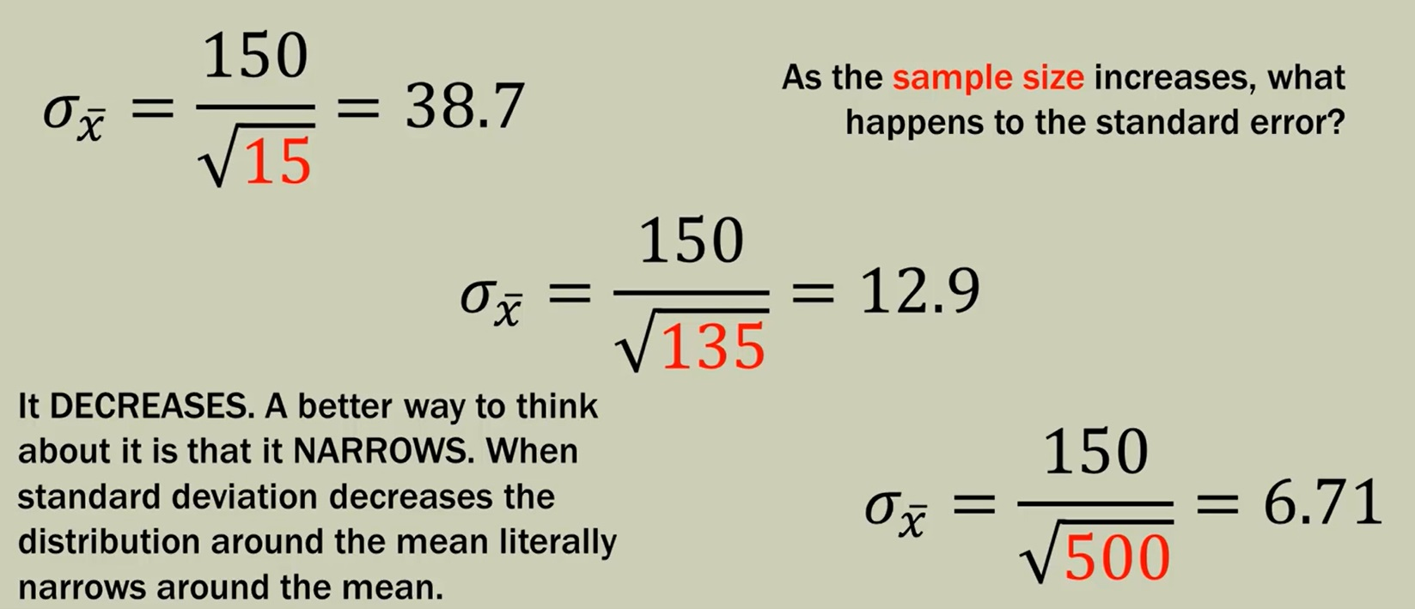
Larger sample size reduces the Standard Error of the Mean (see below in red highlighted texts)

Slide 21
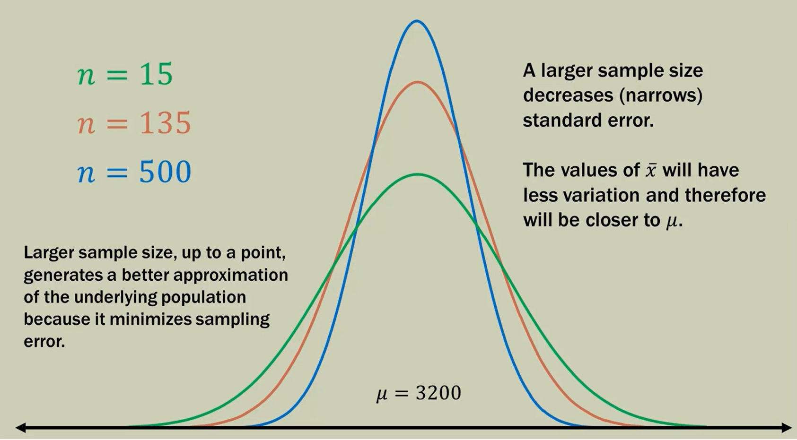
Larger sample size means decreasing standard error

Slide 22
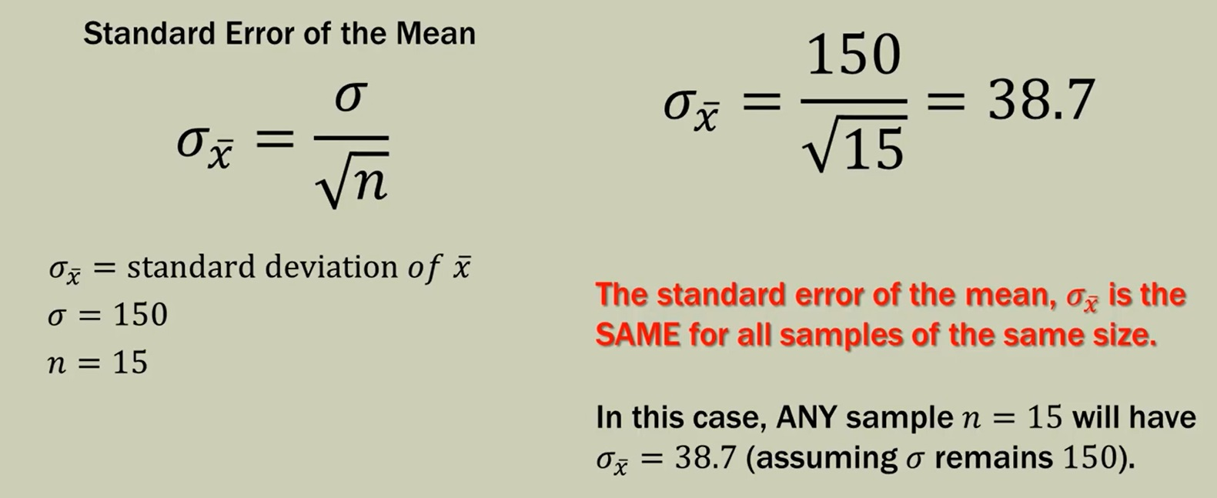
Standard error of the Mean (SEM)

Slide 23
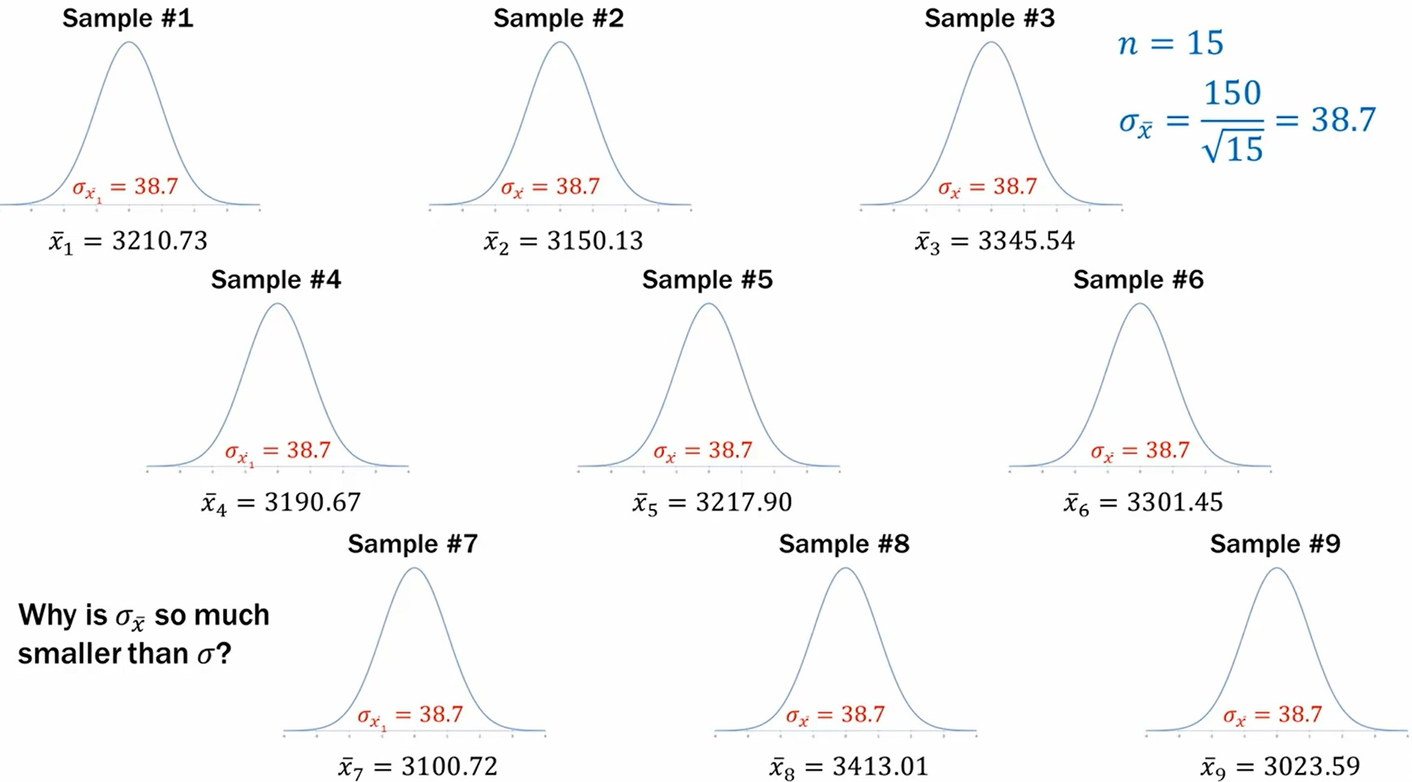
Why SEM is smaller than Standard deviation?
SEM can be completely different in two samples if the population is different.

Slide 24
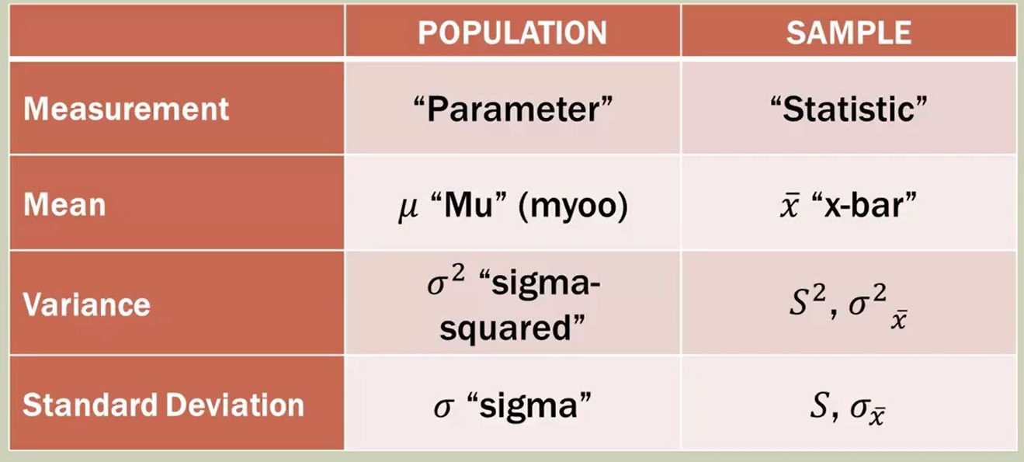
Nomenclature(s) and Symbol(s)

